Slide 1
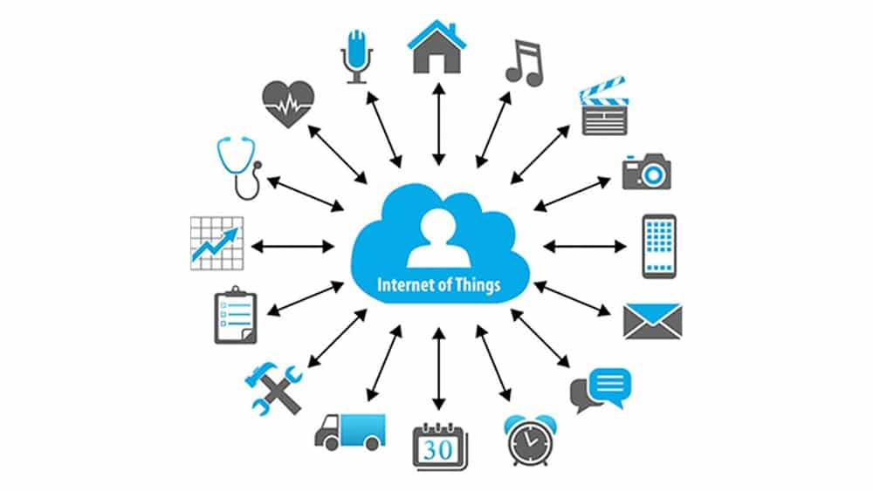
CS8081
INTERNET OF THINGS

Slide 2
INTERNET OF THINGS
UNIT IV
DATA ANALYTICS AND SUPPORTING SERVICES
Structured Vs Unstructured Data and Data in Motion Vs Data in Rest – Role of Machine Learning – No SQL Databases – Hadoop Ecosystem – Apache Kafka, Apache Spark – Edge Streaming Analytics and Network Analytics – Xively Cloud for IoT, Python Web Application Framework – Django – AWS for IoT – System Management with NETCONF-YANG 106

Slide 3
An Introduction to Data Analytics for IoT
In the world of IoT, the creation of massive amounts of data from sensors is common and one of the biggest challenges—not only from a transport perspective but also from a data management standpoint.
A great example of the deluge of data that can be generated by IoT is found in the commercial aviation industry and the sensors that are deployed throughout an aircraft

Slide 4
Commercial Jet Engine

Slide 5
Example
Modern jet engines, similar to the one shown in Figure may be equipped with around 5000 sensors.
Therefore, a twin engine commercial aircraft with these engines operating on average 8 hours a day will generate over 500 TB of data daily, and this is just the data from the engines!
Aircraft today have thousands of other sensors connected to the airframe and other systems.
In fact, a single wing of a modern jumbo jet is equipped with 10,000 sensors.
Petabyte (PB) of data per day per commercial airplane.
Across the world, there are approximately 100,000 commercial flights per day. The amount of IoT data coming just from the commercial airline business is overwhelming

Slide 6
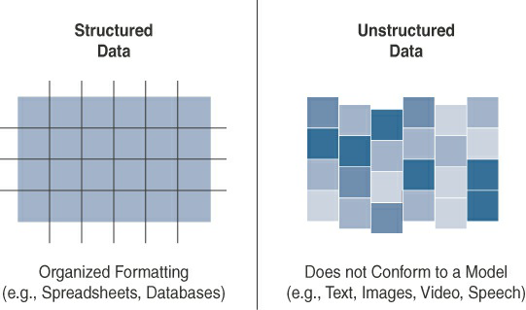
Structured Versus Unstructured Data

Slide 7
Smart objects in IoT networks generate both structured and unstructured data.
Structured data is more easily managed and processed due to its well-defined organization.
On the other hand, unstructured data can be harder to deal with and typically requires very different analytics tools for processing the data.
Being familiar with both of these data classifications is important because knowing which data classification you are working with makes integrating with the appropriate data analytics solution much easier.

Slide 8
Data in Motion Versus Data at Rest
As in most networks, data in IoT networks is either in transit (“data in motion”) or being held or stored (“data at rest”).
Examples of data in motion include traditional client/server exchanges, such as web browsing and file transfers, and email.
Data saved to a hard drive, storage array, or USB drive is data at rest.

Slide 9
From an IoT perspective, the data from smart objects is considered data in motion as it passes through the network en route to its final destination.
This is often processed at the edge, using fog computing.
When data is processed at the edge, it may be filtered and deleted or forwarded on for further processing and possible storage at a fog node or in the data center.
Data does not come to rest at the edge.

Slide 10
When data arrives at the data center, it is possible to process it in real-time, just like at the edge, while it is still in motion.
Tools with this sort of capability, such as Spark, Storm, and Flink, are relatively nascent compared to the tools for analyzing stored data.

Slide 11
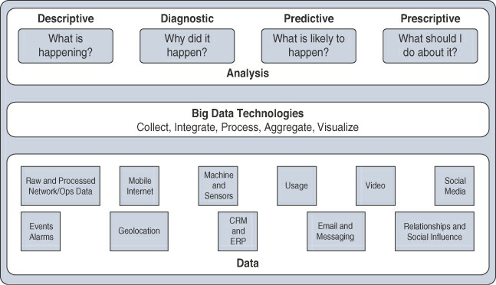
IoT Data Analytics Overview

Slide 12
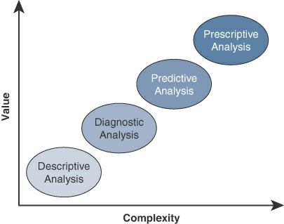
Application of Value and Complexity Factors to the Types of Data Analysis

Slide 13
IoT Data Analytics Challenges
Scaling problems:
Due to the large number of smart objects in most IoT networks that continually send data, relational databases can grow incredibly large very quickly. This can result in performance issues that can be costly to resolve, often requiring more hardware and architecture changes.
Volatility of data:
With relational databases, it is critical that the schema be designed correctly from the beginning. Changing it later can slow or stop the database from operating. Due to the lack of flexibility, revisions to the schema must be kept at a minimum.
IoT data, however, is volatile in the sense that the data model is likely to change and evolve over time. A dynamic schema is often required so that data model changes can be made daily or even hourly.

Slide 14
Machine Learning
One of the core subjects in IoT is how to makes sense of the data that is generated. Because much of this data can appear incomprehensible to the naked eye, specialized tools and algorithms are needed to find the data relationships that will lead to new business insights.
This brings us to the subject of machine learning (ML).

Slide 15
ML is indeed central to IoT. Data collected by smart objects needs to be analyzed, and intelligent actions need to be taken based on these analyses.
Performing this kind of operation manually is almost impossible (or very, very slow and inefficient).
Machines are needed to process information fast and react instantly when thresholds are met.

Slide 16
Machine Learning Overview
Machine learning is, in fact, part of a larger set of technologies commonly grouped under the term artificial intelligence (AI).
This term used to make science fiction amateurs dream of biped robots and conscious machines, or of a Matrix-like world where machines would enslave humankind.
AI includes any technology that allows a computing system to mimic human intelligence using any technique, from very advanced logic to basic “if-then-else” decision loops.

Slide 17
A simple example is an app that can help you find your parked car.
Simple static rule set
In more complex cases, static rules cannot be simply inserted into the program because they require parameters that can change or that are imperfectly understood.
A typical example is a dictation program that runs on a computer.
The program is configured to recognize the audio pattern of each word in a dictionary, but it does not know your voice’s accent, tone, speed, and so on.

Slide 18
You need to record a set of predetermined sentences to help the tool match well-known words to the sounds you make when you say the words.
This process is called machine learning. ML is concerned with any process where the computer needs to receive a set of data that is processed to help perform a task with more efficiency.

Slide 19
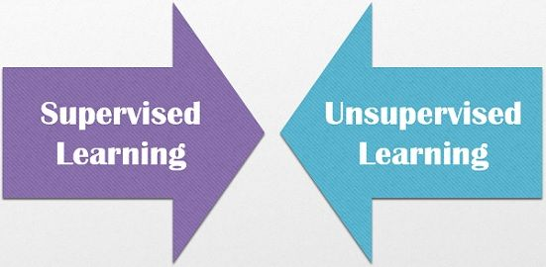
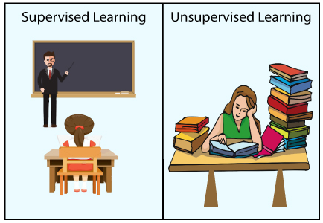

Slide 20
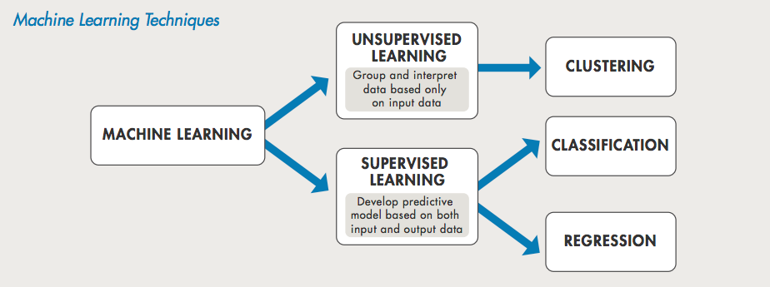

Slide 22
Supervised Learning | Unsupervised Learning
Supervised learning algorithms are trained using labeled data. | Unsupervised learning algorithms are trained using unlabeled data.
Supervised learning model takes direct feedback to check if it is predicting correct output or not. | Unsupervised learning model does not take any feedback.
Supervised learning model predicts the output. | Unsupervised learning model finds the hidden patterns in data.
In supervised learning, input data is provided to the model along with the output. | In unsupervised learning, only input data is provided to the model.
The goal of supervised learning is to train the model so that it can predict the output when it is given new data. | The goal of unsupervised learning is to find the hidden patterns and useful insights from the unknown dataset.
Supervised learning needs supervision to train the model. | Unsupervised learning does not need any supervision to train the model.

Slide 23
Supervised Learning | Unsupervised Learning
Supervised learning can be categorized in Classification and Regression problems. | Unsupervised Learning can be classified in Clustering and Associations problems.
Supervised learning can be used for those cases where we know the input as well as corresponding outputs. | Unsupervised learning can be used for those cases where we have only input data and no corresponding output data.
Supervised learning model produces an accurate result. | Unsupervised learning model may give less accurate result as compared to supervised learning.
Supervised learning is not close to true Artificial intelligence as in this, we first train the model for each data, and then only it can predict the correct output. | Unsupervised learning is more close to the true Artificial Intelligence as it learns similarly as a child learns daily routine things by his experiences.
It includes various algorithms such as Linear Regression, Logistic Regression, Support Vector Machine, Multi-class Classification, Decision tree, Bayesian Logic, etc. | It includes various algorithms such as Clustering, KNN, and Apriori algorithm.

Slide 24
Neural networks
ML methods that mimic the way the human brain works.
When you look at a human figure, multiple zones of your brain are activated to recognize colors, movements, facial expressions, and so on.
Your brain combines these elements to conclude that the shape you are seeing is human. Neural networks mimic the same logic

Slide 25
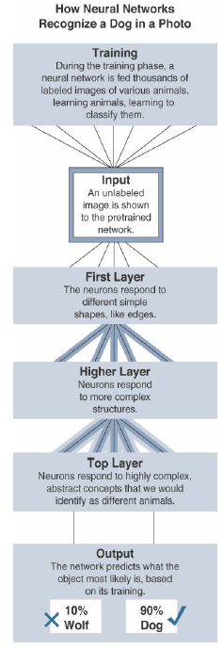

Slide 26
Introduction to NoSQL Databases
A database Management System provides the mechanism to store and retrieve the data.
There are different kinds of database Management Systems: 1. RDBMS (Relational Database Management Systems) 2. OLAP (Online Analytical Processing) 3. NoSQL (Not only SQL)

Slide 27
What is a NoSQL database?
NoSQL databases are different than relational databases like MQSql.
In relational database you need to create the table, define schema, set the data types of fields etc before you can actually insert the data.
In NoSQL you don’t have to worry about that, you can insert, update data on the fly.

Slide 28
One of the advantage of NoSQL database is that they are really easy to scale and they are much faster in most types of operations that we perform on database.
There are certain situations where you would prefer relational database over NoSQL, however when you are dealing with huge amount of data then NoSQL database is your best choice.

Slide 29
Limitations of Relational databases
1. In relational database we need to define structure and schema of data first and then only we can process the data.
2. Relational database systems provides consistency and integrity of data by enforcing ACID properties (Atomicity, Consistency, Isolation and Durability ). There are some scenarios where this is useful like banking system. However in most of the other cases these properties are significant performance overhead and can make your database response very slow.
3. Most of the applications store their data in JSON format and RDBMS don’t provide you a better way of performing operations such as create, insert, update, delete etc on this data. On the other hand NoSQL store their data in JSON format, which is compatible with most of the today’s world application.

Slide 30
What are the advantages of NoSQL
High scalability
High Availability
Here are the types of NoSQL databases and the name of the databases system that falls in that category. MongoDB falls in the category of NoSQL document based database. Key Value Store: Memcached, Redis, Coherence Tabular: Hbase, Big Table, Accumulo Document based: MongoDB, CouchDB, Cloudant

Slide 31
When to go for NoSQL
When you would want to choose NoSQL over relational database:
When you want to store and retrieve huge amount of data.
The relationship between the data you store is not that important
The data is not structured and changing over time
Constraints and Joins support is not required at database level
The data is growing continuously and you need to scale the database regular to handle the data.

Slide 32
HADOOP Overview
Apache Hadoop is an open source framework intended to make interaction with big data easier.
Hadoop has made its place in the industries and companies that need to work on large data sets which are sensitive and needs efficient handling.
Hadoop is a framework that enables processing of large data sets which reside in the form of clusters.
Being a framework, Hadoop is made up of several modules that are supported by a large ecosystem of technologies.

Slide 33
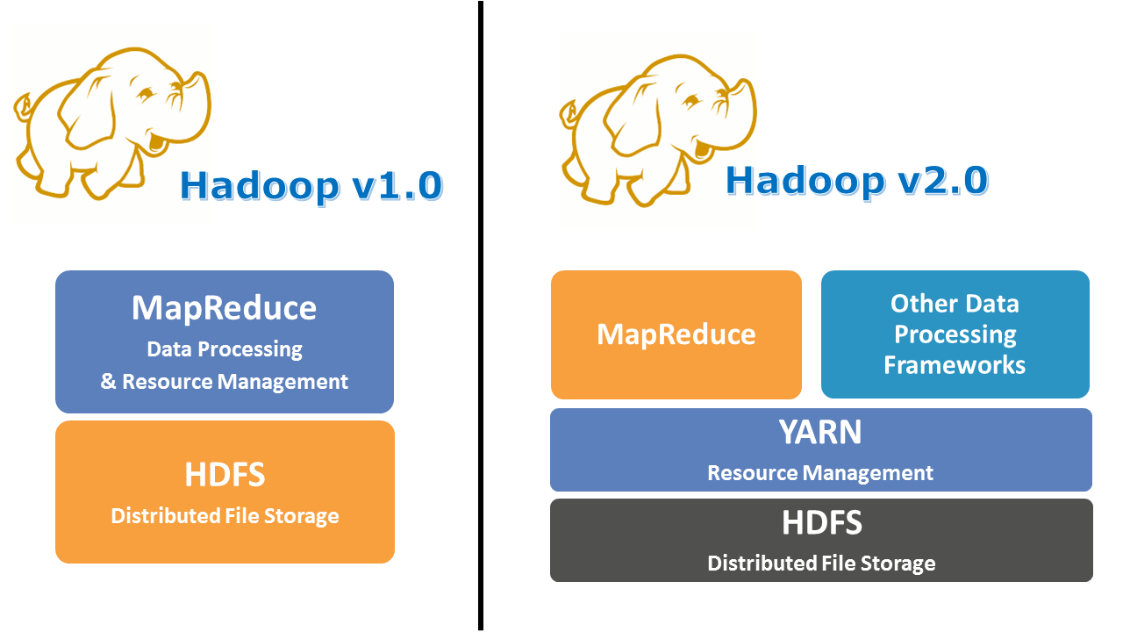
HADOOP ARCHITECTURE Vs ECOSYSTEM

Slide 34
Hadoop Architecture
Hadoop has two major layers namely
MapReduce
Processing/Computation layer
Storage layer Hadoop Distributed File System
HDFS

Slide 35
Hadoop Ecosystem
Hadoop Ecosystem is a platform or a suite which provides various services to solve the big data problems.
It includes Apache projects and various commercial tools and solutions.
There are four major elements of Hadoop i.e. HDFS, MapReduce, YARN, and Hadoop Common
Most of the tools or solutions are used to supplement or support these major elements.
All these tools work collectively to provide services such as absorption, analysis, storage and maintenance of data etc.

Slide 36
Following are the components that collectively form a Hadoop ecosystem
HDFS: Hadoop Distributed File System
YARN: Yet Another Resource Negotiator
MapReduce: Programming based Data Processing
Spark: In-Memory data processing
PIG, HIVE: Query based processing of data services
HBase: NoSQL Database
Mahout, Spark MLLib: Machine Learning algorithm libraries
Solar, Lucene: Searching and Indexing
Zookeeper: Managing cluster
Oozie: Job Scheduling

Slide 38
Hadoop Distributed File System
HDFS is the primary or major component of Hadoop ecosystem and is responsible for storing large data sets of structured or unstructured data across various nodes and thereby maintaining the metadata in the form of log files.
HDFS splits files into blocks and sends them across various nodes in form of large clusters. Also in case of a node failure, the system operates and data transfer takes place between the nodes which are facilitated by HDFS.
It is highly fault-tolerant and is designed to be deployed on low-cost hardware.
It provides high throughput access to application data and is suitable for applications having large datasets.

Slide 39
HDFS consists of two core components i.e.
Name node
Data Node
Name Node is the prime node which contains metadata (data about data) requiring comparatively fewer resources than the data nodes that stores the actual data. These data nodes are commodity hardware in the distributed environment. Undoubtedly, making Hadoop cost effective.
HDFS maintains all the coordination between the clusters and hardware, thus working at the heart of the system.

Slide 40
HDFS
HDFS holds very large amount of data and provides easier access.
To store such huge data, the files are stored across multiple machines.
These files are stored in redundant fashion to rescue the system from possible data losses in case of failure.
HDFS also makes applications available to parallel processing

Slide 41
Features of HDFS
It is suitable for the distributed storage and processing.
Hadoop provides a command interface to interact with HDFS.
The built-in servers of namenode and datanode help users to easily check the status of cluster.
Streaming access to file system data.
HDFS provides file permissions and authentication.

Slide 42
Advantages of HDFS
It is inexpensive,
Immutable in nature,
Stores data reliably,
Ability to tolerate faults,
Scalable,
Block structured,
Can process a large amount of data simultaneously and many more.

Slide 43
YARN
Yet Another Resource Negotiator, as the name implies, YARN is the one who helps to manage the resources across the clusters.
In short, it performs scheduling and resource allocation for the Hadoop System.
Consists of three major components i.e.
Resource Manager
Nodes Manager
Application Manager
Resource manager has the privilege of allocating resources for the applications in a system whereas Node managers work on the allocation of resources such as CPU, memory, bandwidth per machine and later on acknowledges the resource manager.
Application manager works as an interface between the resource manager and
Node manager and performs negotiations as per the requirement of the two.

Slide 44
YARN Architecture

Slide 45
YARN
Apache Yarn – “Yet Another Resource Negotiator” is the resource management layer of Hadoop.
The Yarn was introduced in Hadoop 2.x. Yarn allows different data processing engines like graph processing, interactive processing, stream processing as well as batch processing to run and process data stored in HDFS. Apart from resource management, Yarn also does job Scheduling.

Slide 46
MapReduce
MapReduce is a parallel programming model for writing distributed applications devised at Google for efficient processing of large amounts of data multi−terabyte data sets−on large clusters thousands of nodes of commodity hardware in a reliable, fault-tolerant manner.
The MapReduce program runs on Hadoop which is an Apache open-source framework.

Slide 47
MapReduce
By making the use of distributed and parallel algorithms, MapReduce makes it possible to carry over the processing’s logic and helps to write applications which transform big data sets into a manageable one.
MapReduce makes the use of two functions i.e. Map() and Reduce() whose task is:
Map() performs sorting and filtering of data and thereby organizing them in the form of group. Map generates a key-value pair based result which is later on processed by the Reduce() method.
Reduce(), as the name suggests does the summarization by aggregating the mapped data. In simple, Reduce() takes the output generated by Map() as input and combines those tuples into smaller set of tuples.

Slide 48
PIG
Pig was basically developed by Yahoo which works on a pig Latin language, which is Query based language similar to SQL.
It is a platform for structuring the data flow, processing and analyzing huge data sets.
Pig does the work of executing commands and in the background, all the activities of MapReduce are taken care of. After the processing, pig stores the result in HDFS.
Pig Latin language is specially designed for this framework which runs on Pig Runtime. Just the way Java runs on the JVM.
Pig helps to achieve ease of programming and optimization and hence is a major segment of the Hadoop Ecosystem.

Slide 49
HIVE
With the help of SQL methodology and interface, HIVE performs reading and writing of large data sets. However, its query language is called as HQL (Hive Query Language).
It is highly scalable as it allows real-time processing and batch processing both. Also, all the SQL data types are supported by Hive thus, making the query processing easier.
Similar to the Query Processing frameworks, HIVE too comes with two components: JDBC Drivers and HIVE Command Line.
JDBC, along with ODBC drivers work on establishing the data storage permissions and connection whereas HIVE Command line helps in the processing of queries.

Slide 50
Mahout
Mahout, allows Machine Learnability to a system or application.
Machine Learning, as the name suggests helps the system to develop itself based on some patterns, user/environmental interaction or on the basis of algorithms.
It provides various libraries or functionalities such as collaborative filtering, clustering, and classification which are nothing but concepts of Machine learning.
It allows invoking algorithms as per our need with the help of its own libraries.

Slide 51
Apache Spark
It’s a platform that handles all the process consumptive tasks like batch processing, interactive or iterative real-time processing, graph conversions, and visualization, etc.
It consumes in memory resources hence, thus being faster than the prior in terms of optimization.
Spark is best suited for real-time data whereas Hadoop is best suited for structured data or batch processing, hence both are used in most of the companies interchangeably.

Slide 52
Apache HBase
It’s a NoSQL database which supports all kinds of data and thus capable of handling anything of Hadoop Database. It provides capabilities of Google’s BigTable, thus able to work on Big Data sets effectively.
At times where we need to search or retrieve the occurrences of something small in a huge database, the request must be processed within a short quick span of time. At such times, HBase comes handy as it gives us a tolerant way of storing limited data

Slide 53
Other Components
Apart from all of these, there are some other components too that carry out a huge task in order to make Hadoop capable of processing large datasets. They are as follows:
Solr, Lucene: These are the two services that perform the task of searching and indexing with the help of some java libraries, especially Lucene is based on Java which allows spell check mechanism, as well.

Slide 54
Zookeeper: There was a huge issue of management of coordination and synchronization among the resources or the components of Hadoop which resulted in inconsistency, often. Zookeeper overcame all the problems by performing synchronization, inter-component based communication, grouping, and maintenance.
Oozie: Oozie simply performs the task of a scheduler, thus scheduling jobs and binding them together as a single unit.
There is two kinds of jobs .i.e Oozie workflow and Oozie coordinator jobs. Oozie workflow is the jobs that need to be executed in a sequentially ordered manner whereas Oozie Coordinator jobs are those that are triggered when some data or external stimulus is given to it.

Slide 55
Since the initial release of Hadoop in 2011, many projects have been developed to add incremental functionality to Hadoop and have collectively become known as the Hadoop ecosystem.
Hadoop now comprises more than 100 software projects under the Hadoop umbrella, capable of nearly every element in the data lifecycle, from collection, to storage, to processing, to analysis and visualization.
Each of these individual projects is a unique piece of the overall data management solution.

Slide 56
Apache Kafka
Part of processing real-time events, such as those commonly generated by smart objects, is having them ingested into a processing engine.
The process of collecting data from a sensor or log file and preparing it to be processed and analyzed is typically handled by messaging systems.
Messaging systems are designed to accept data, or messages, from where the data is generated and deliver the data to stream-processing engines such as Spark Streaming or Storm.

Slide 57
Apache Kafka is a distributed publisher-subscriber messaging system that is built to be scalable and fast.
It is composed of message brokers, where producers write data and consumers read data from these brokers.
The data flow from the smart objects (producers), through a topic in Kafka, to the real-time processing engine.

Slide 58
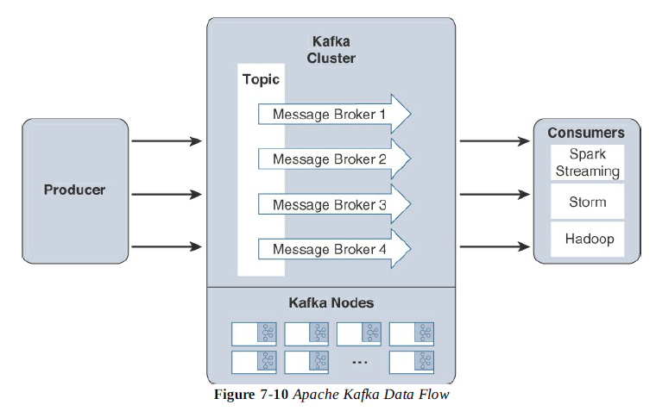

Slide 59
Due to the distributed nature of Kafka, it can run in a clustered configuration that can handle many producers and consumers simultaneously and exchanges information between nodes, allowing topics to be distributed over multiple nodes.
The goal of Kafka is to provide a simple way to connect to data sources and allow consumers to connect to that data in the way they would like.

Slide 60
Apache Spark
Apache Spark is an in-memory distributed data analytics platform designed to accelerate processes in the Hadoop ecosystem.
The “in-memory” characteristic of Spark is what enables it to run jobs very quickly.
At each stage of a MapReduce operation, the data is read and written back to the disk, which means latency is introduced through each disk operation.
However, with Spark, the processing of this data is moved into high-speed memory, which has significantly lower latency. This speeds the batch processingjobs and also allows for near-real-time processing of events.

Slide 61
Real-time processing is done by a component of the Apache Spark project called Spark Streaming.
Spark Streaming is an extension of Spark Core that is responsible for taking live streamed data from a messaging system, like Kafka, and dividing it into smaller micro batches.
These microbatches are called discretized streams, or DStreams.
The Spark processing engine is able to operate on these smaller pieces of data, allowing rapid insights into the data and subsequent actions.
Due to this “instant feedback” capability, Spark is becoming an important component in many IoT deployments.

Slide 62
Systems that control
safety and security of personnel,
time-sensitive processes in the manufacturing space,
and infrastructure control in traffic management
all benefit from these real-time streaming capabilities.

Slide 63
Xively Cloud for IoT
Xively (formerly known as Cosm and Pachube) is an Internet of Things (IoT) platform owned by Google.
Xively offers product companies a way to connect products, manage connected devices and the data they produce, and integrate that data into other sy
A Platform as a Service built for the IoT.
Includes directory services, data services, a trust engine for security, and web-based management application.
Xively's messaging is built on a protocol called MQTT.
The API supports REST, WebSockets and MQTT.

Slide 64
Xively is a system for deploying IoT applications on the cloud. It is offered as PaaS.
Xively is basically a data collection, management, and distribution infrastructure.
It also provides APIs to connect and develop IoT applications.

Slide 65
Xively also provides tools to model your connected business.
This capability is highly beneficial to build any IoT based product.
Other than that Xively also provides Management as well as operational tools.
Xively can be connected to most of the IoT frameworks and microcontrollers in the market to create a ‘smart’ project or product.

Slide 66
Xively Python Libraries can also be used to embed python code as per the Xively APIs.
A Xively Web interface is provided to be used for easy implementation of front end interface.
Xively also comes with multiple language and platform support. We can implement HTTP protocols, APIs, MQTT.
This makes the device connectivity a lot easier with Xively cloud

Slide 67
All the devices can be connected to Xively Cloud for real-time processing and archiving to cloud.
IOT application developers can write the frontend for IoT applications as per their requirements.
This helps in convenient management of apps with Xively cloud and other APIs.

Slide 68
Xively is very popular with companies which deal with IoT based device manufacturing and development.
Companies using Xively can rely on the secure connectivity of devices as well as the seamless data management capability.

Slide 69
How to use Xively?
Programmers or Developers have to register with Xively to use cloud services.
After registration and account creation, developers can create different devices for which he has to create an IoT app. It can be easily done using the templates provided in the Web Interface of Xively.
Each connected devices is allocated a unique FEED_ID. It specifies the data stream and metadata of the connected device.
Once this is done permissions on the IoT devices are assigned using the available APIs. The available permissions are Create, Update, Delete and Read.
One or more bidirectional channels are created after we connect a device with Xively. Each channel is unique to the device connected.
Xively cloud is connected with the help of these channels.
Xively APIs are used by IoT devices to create communication enabled products.

